Slide 1
Bayesian decision theory
Paul Schrater University of Minnesota

Slide 2
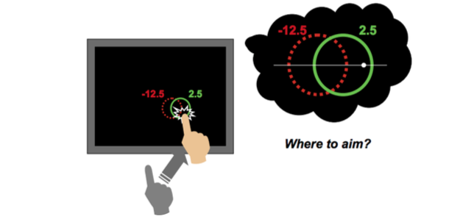
Example decision: End point planning

Slide 3
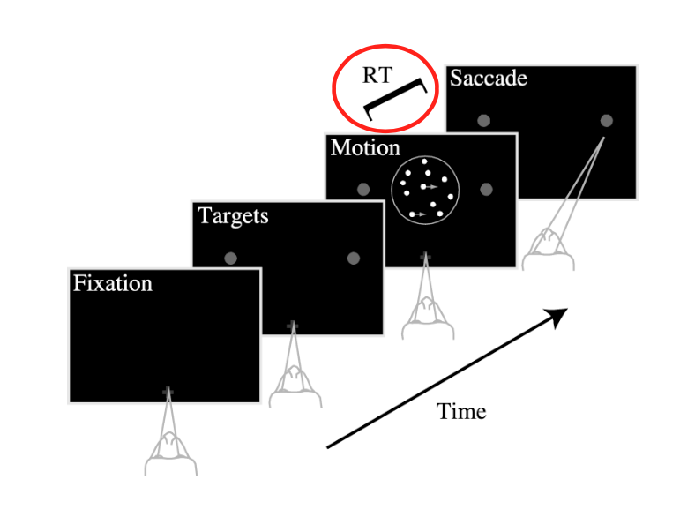
Example decision: Random Dot Coherent motion paradigm

Slide 4
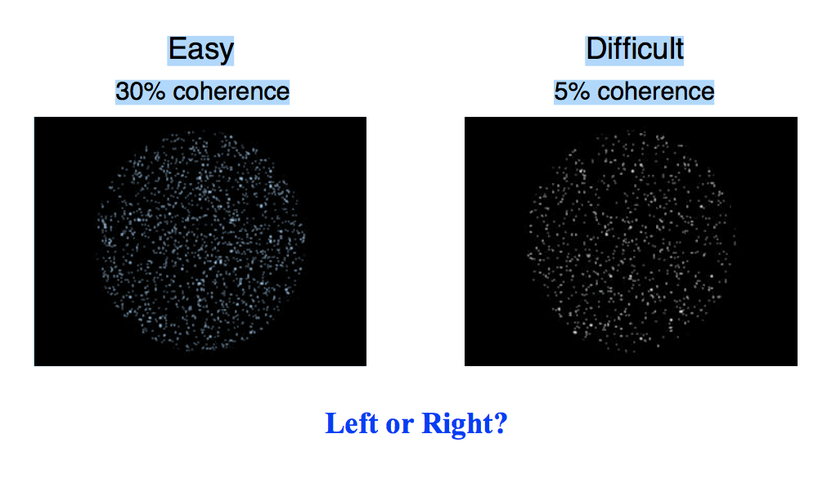
Example decision: Random Dot Coherent motion paradigm

Slide 5
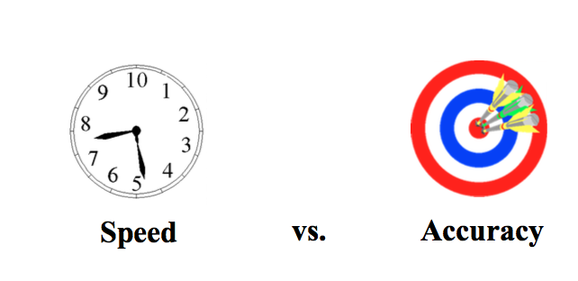
Example decision: Random Dot Coherent motion paradigm
When to initiate movement?

Slide 6
Basic Decision Components
Sensory Space (Observable variables)
x = {x₁,...., x_{t} }
State Space (hidden variables)
s = {s₁,...., s_{t} }
Action Space (controllable variables)
a = {a₁,...., a_{t} }
Outcome Space (variables affecting costs/rewards)
o = {o₁,...., o_{t} }

Slide 7
Model components
Sensory Likelihood
Prior
Outcomes
Rewards/Costs
P(x|s)
P(s)
P(o|a,s)
L(o,a)

Slide 8
Goal
Find Policy: Map between observations and actions
That minimizes Expected Reward/Costs
Where
a = π(x) OR P(a|x)
a* = π(x)
= arg min_{a} L(a|x)
L(a|x) = ∑_{o}∑_{s} L(o,a) P(o|s,a) P(s|x)

Slide 9
Decision Steps
Infer current Bayesian inference:
Forecast Outcome probabilities for each action
Compute Expected Reward/Costs
Optimize the expected cost function to find best policy
P(s|x) = P(x|s) P(s)
∑_{s} P(x|s) P(s)
P(o|a,x) = ∑_{s} P(o|s,a) P(s|x)
L(a|x) = ∑_{o} L(o,a) P(o|a,x)

Slide 10
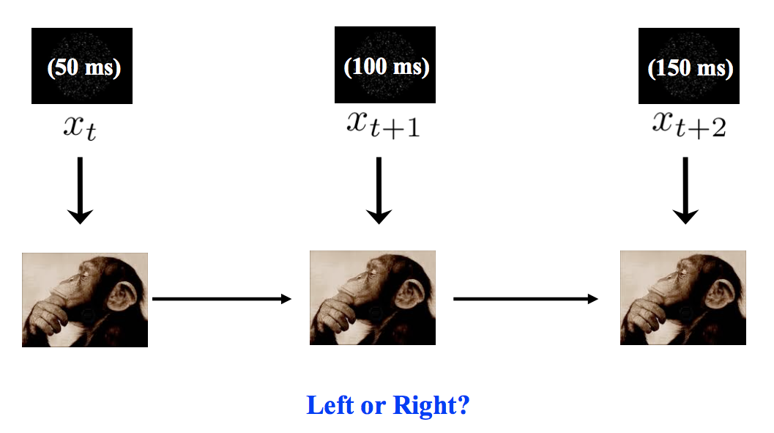
Policy: Sensory history -> choice

Slide 11
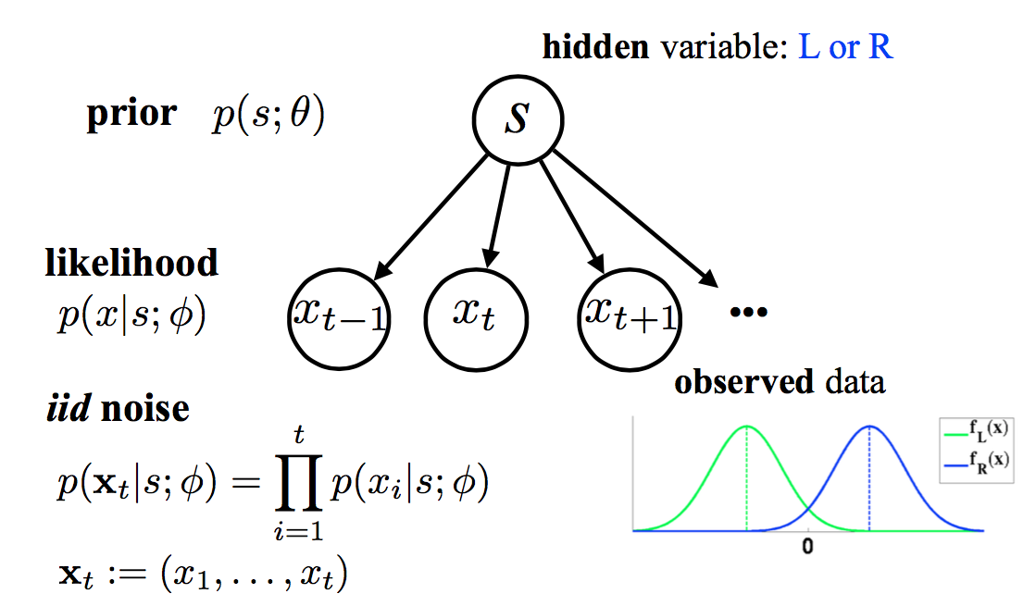
Bayesian Inference of hidden state

Slide 12
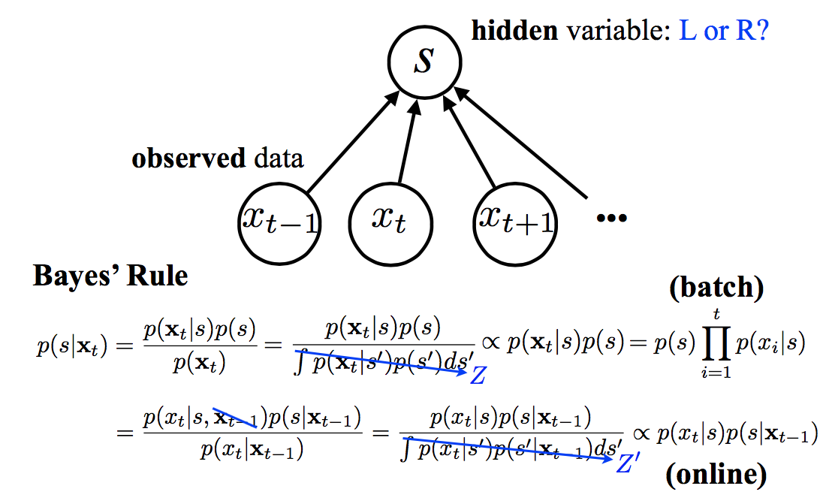
Bayesian Inference

Slide 13
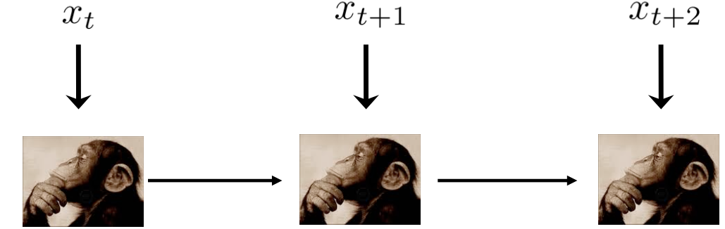

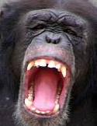
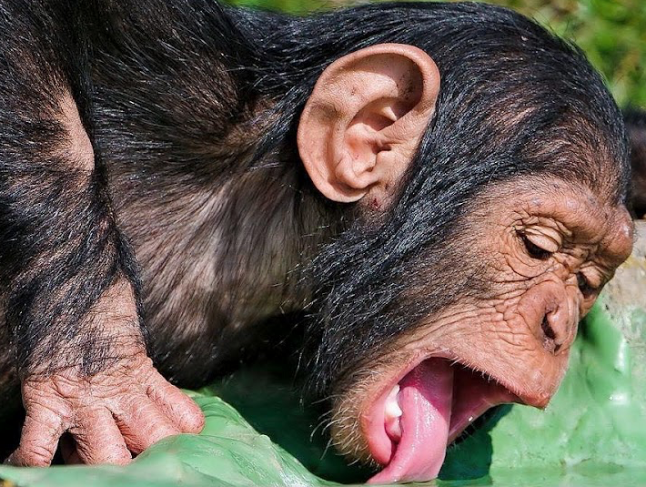
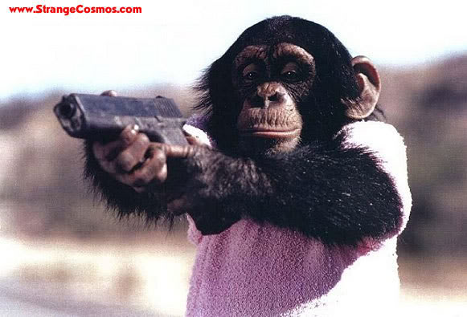
Outcome forecast
Sensory stream
Actions
(stoptime(τ), L/R)
L
R
thirstier
Size =
Outcome
Probability
thirst
thirstiest
Thirst accrues with elapsed time

Slide 14
Outcome probability
P(o|s,a) = P(thirst = t, Juice |s, a_{τ}, a_{L/R} )
= δ(t-a_{τ}) δ(s-a_{L/R})
The thirst state is however much time
has elapsed till decision
The juice state is true if the reward location s
matches the choice action

Slide 15
Expected Cost
Simple cost function
Average amount of juice per unit time
where T is the intertrial interval
Expected cost
L(o,a) = J/(τ+Τ)
L(a|x) = ∑_{o}∑_{s} L(o,a) P(o|s,a) P(s|x)
L(a|x) = ∑_{o}∑_{s} (J/τ) δ(t-a_{τ}) δ(s-a_{L/R}) P(s|x)
L(a_{L,} a_{τ}|x) = J/(a_{τ} +Τ) P_{τ} (a_{L}|x)

Slide 16
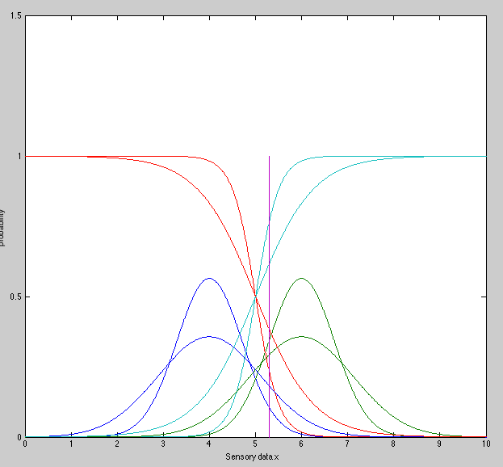
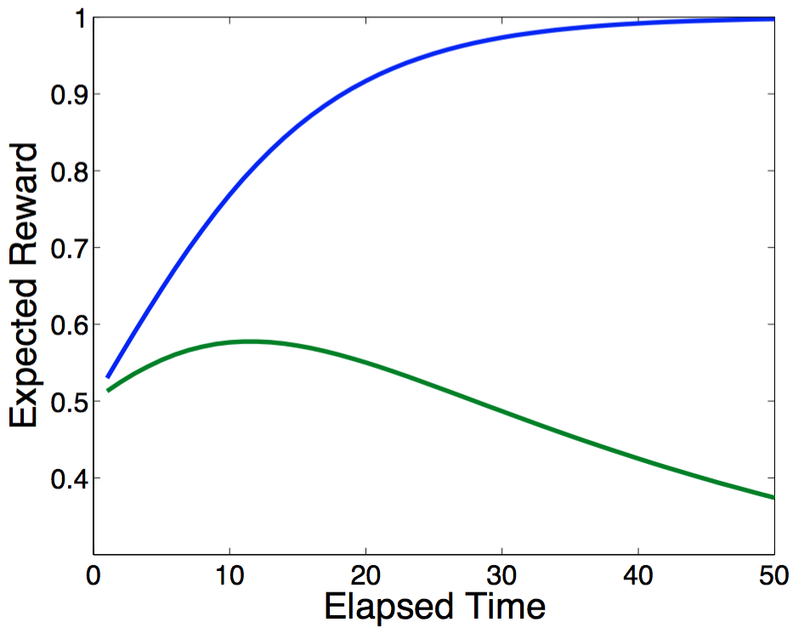
Simulating
P(s|x) as a
function of time
x=5.3
P_{τ} (a_{L}|x)
L(a_{L,} a_{τ}|x=5.3)

Slide 17
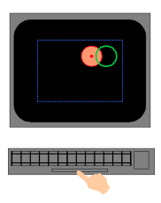
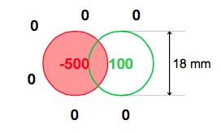
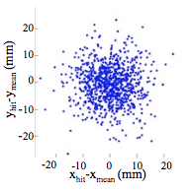
Example decision: End point planning
Action
Reward/Cost
State

Slide 18
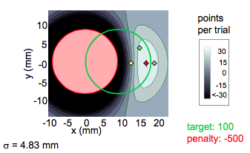
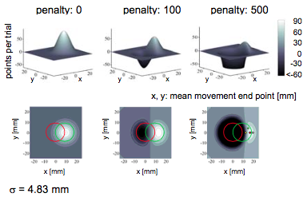
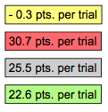
Expected Gain

Slide 19
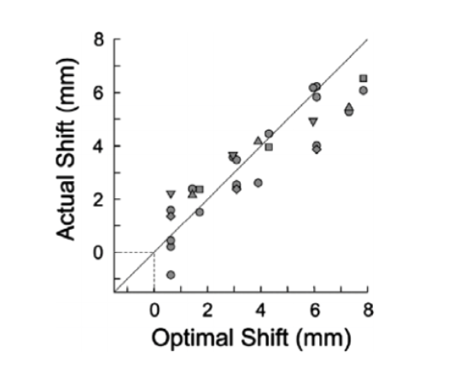
Behavior

Slide 20
Let’s derive this

Slide 21
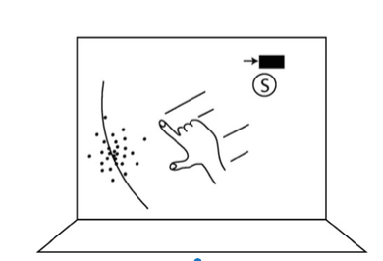
Battaglia and Schrater
Deadline = 1400 msec
Dots accumulate while finger on button
Reach to intercept centroid before deadline

Slide 22
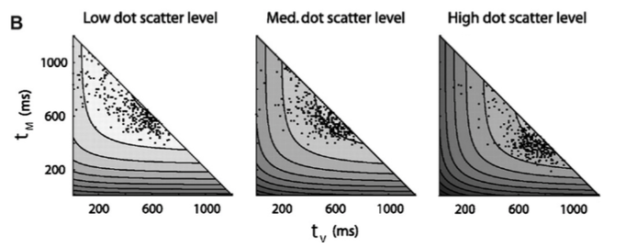
Battaglia and Schrater
State?
Actions?
Outcomes?

